Slide 1


Soumyajit Chowdhury
21st April, 2023

Slide 2

Outline
Executive Summary
Introduction
Methodology
Results
Conclusion
Appendix

Slide 3
Executive Summary
Summary of methodologies
Data Collection, from public SpaceX API and SpaceX Wikipedia page.
Data wrangling, including adding an indicator for successful landings.
EDA, via SQL queries and various visualizations and data summaries.
Explored and analyzed further, using Folium to generate interactive maps.
Interactive dashboard developed with Plotly Dash.
Machine learning models trained to predict successful landings through classification techniques.
Summary of all results
The resulting models all produced similar results, with an accuracy rate of -94.44% when tested with a test data set. The models tended to over predict successful landings. Training the model with more data could lead to improved accuracy.

Slide 4
Introduction
Project background and context
SpaceX offers Falcon 9 rocket launches for 62 million dollars, significantly less than other providers who charge upward of 165 million dollars. One reason for the low cost is the ability to reuse the first stage of the rocket, which provides the initial thrust to get the spacecraft off the ground and into space. If the first stage lands successfully, SpaceX can reuse it on future launches, significantly reducing the cost of the launch. However, if the first stage doesn't land successfully, a new first stage needs to be built, which increases the cost. This information can help an alternate company estimate the cost of a competitive bid.
Problems you want to find answers
What are the factors that affect the probability of a rocket successfully landing?
What are the optimal conditions required for a successful rocket landing?

Slide 5

Section 1

Slide 6
Methodology
Executive Summary
Data collection methodology:
Using SpaceX REST API & WEB SCRAPING SPACEX Wikipedia Page
Perform data wrangling
Removing Irrelevant fields & Imputing NULL Values
Using One Hot Encoding
Perform exploratory data analysis (EDA) using visualization and SQL
Perform interactive visual analytics using Folium and Plotly Dash
Perform predictive analysis using classification models

Slide 7
Data Collection
SPACEX REST API
The data includes information about payload, landing outcome & other launches & landing specifications in the form of .JSON file. Data is normalized into a flat .CSV file.
WEB SCRAPING
Scraping the Wikipedia page the data is collected using Beautiful Soup. At last normalized into a flat .CSV file.

Slide 8
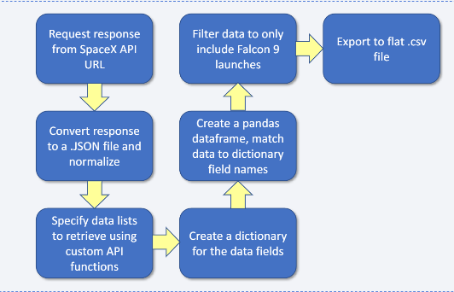
Data Collection – SpaceX API
Flowchart
IBM-Data-Science/Data Collection API .ipynb at main · soumojeet/IBM-Data-Science (github.com)

Slide 9
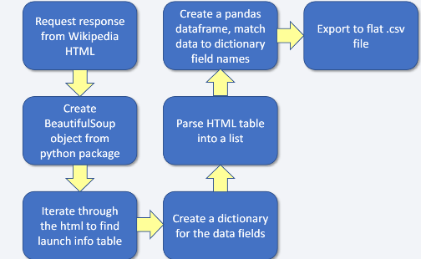
Data Collection - Scraping
Flowchart
IBM-Data-Science/Data Collection with Web Scraping.ipynb at main · soumojeet/IBM-Data-Science (github.com)

Slide 10
Data Wrangling
Two Components: 'Mission Outcome' & 'Landing Outcome'
Successful Landing = 1 & Unsuccessful Landing = 0
Value Mapping:
Outcomes 'True ASDS', 'True RTLS' & 'True Ocean' - set Class 1
Outcomes 'None None', 'False ASDS', 'None ASDS', 'False Ocean', 'False RTLS' - set Class 0
IBM-Data-Science/Data Wrangling.ipynb at main · soumojeet/IBM-Data-Science (github.com)

Slide 11
EDA with Data Visualization
Relationship between variables 'Flight Number', 'Payload Mass', 'Launch Site', 'Orbit', 'Class' & 'Year'.
Scatter Plots:
Flight number Vs Payload Mass
Flight Number Vs Launch Site
Payload Vs Launch Site
Orbit Vs Flight Number
Payload Vs Orbit Type
Orbit Vs Payload Mass
Bar Charts
Mean Vs Orbit
Line Charts
Success Rate Vs Year
IBM-Data-Science/EDA with Data Visualization.ipynb at main · soumojeet/IBM-Data-Science (github.com)

Slide 12
EDA with SQL
Display the names of the unique launch sites in the space mission
Display 5 records where launch sites begin with the string 'CCA'
Display the total payload mass carried by boosters launched by NASA (CRS)
Display average payload mass carried by booster version F9 v1.1
List the date when the first successful landing outcome in ground pad was acheive.
List the names of the boosters which have success in drone ship and have payload mass greater than 4000 but less than 6000
List the total number of successful and failure mission outcomes
List the names of the booster_versions which have carried the maximum payload mass. Use a subquery
List the records which will display the month names, failure landing_outcomes in drone ship ,booster versions, launch_site for the months in year 2015.
Rank the count of successful landing_outcomes between the date 04-06-2010 and 20-03-2017 in descending order.
IBM-Data-Science/EDA with SQL.ipynb at main · soumojeet/IBM-Data-Science (github.com)

Slide 13
Build an Interactive Map with Folium
Visualize the launch data onto an interactive map. Using latitude & longitude coordinates of each launch site, we add markers at the launch site. We can calculate distance to key locations on the map and mark a line on the map to visualize. E.g. Distance to nearest Railway, Highway, Coast & City.
IBM-Data-Science/Interactive Visual Analytics with Folium.ipynb at main · soumojeet/IBM-Data-Science (github.com)

Slide 14
Build a Dashboard with Plotly Dash
Dashboard including Pie Chart & Scatter Plot
Interactive Charts to Visualize Site Success Rate, Distribution of Successful Landings Across All Launch Sites Or Distribution of Successful Landings for Specific Individual Launch Sites
Interactive Plots to Visualize Success Varies Dependent on Payload Mass & Booster Version Category
IBM-Data-Science/Build an Interactive Dashboard with Ploty Dash.py at main · soumojeet/IBM-Data-Science (github.com)

Slide 15
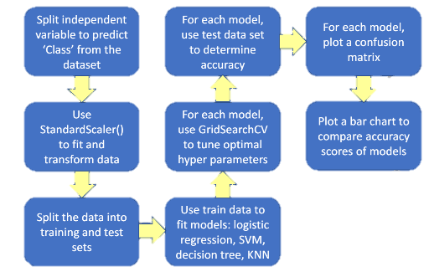
Predictive Analysis (Classification)
Flowchart
IBM-Data-Science/Machine Learning Prediction lab.ipynb at main · soumojeet/IBM-Data-Science (github.com)

Slide 16
Results
Exploratory data analysis results
Interactive analytics demo in screenshots
Predictive analysis results

Slide 17

Section 2

Slide 18
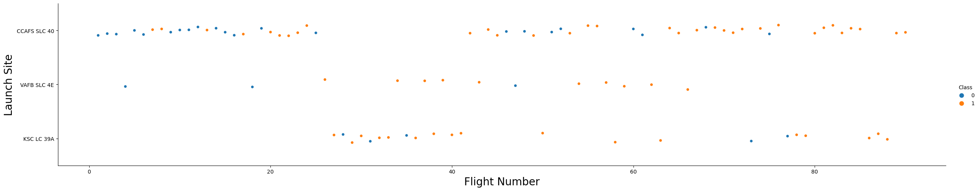
Flight Number vs. Launch Site

Slide 19
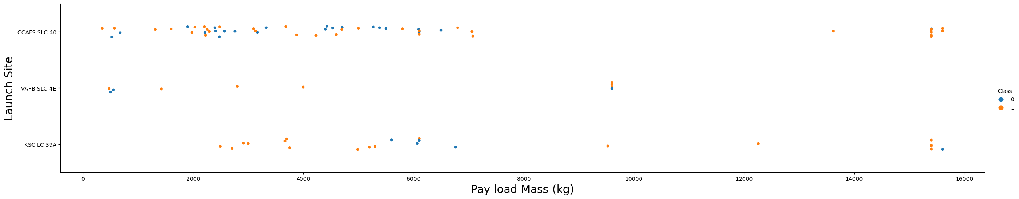
Payload vs. Launch Site

Slide 20
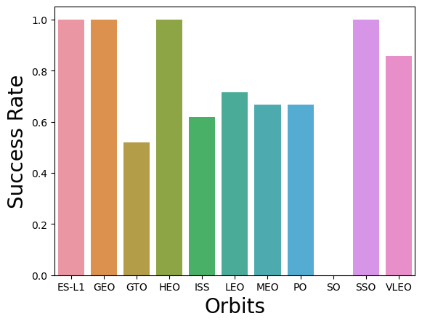
Success Rate vs. Orbit Type

Slide 21
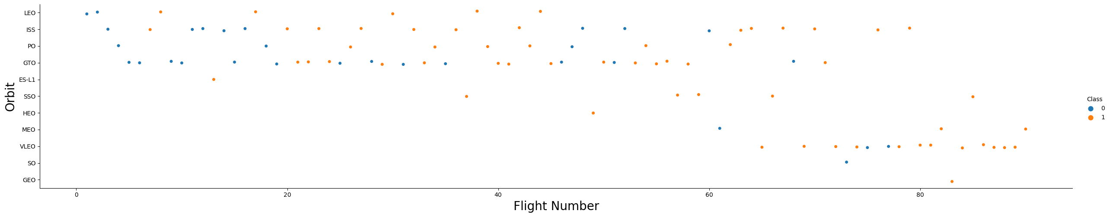
Flight Number vs. Orbit Type

Slide 22
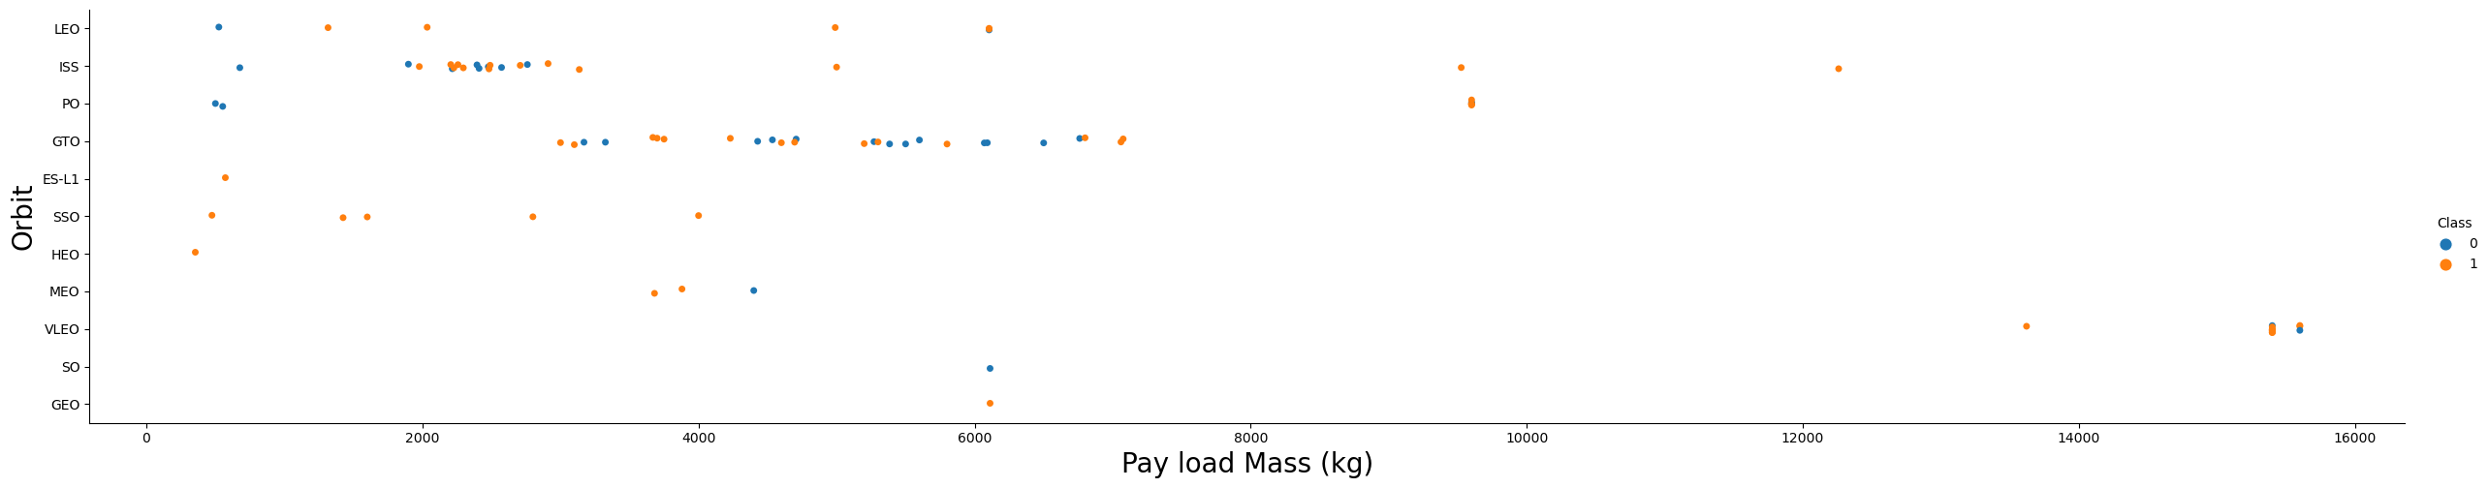
Payload vs. Orbit Type

Slide 23
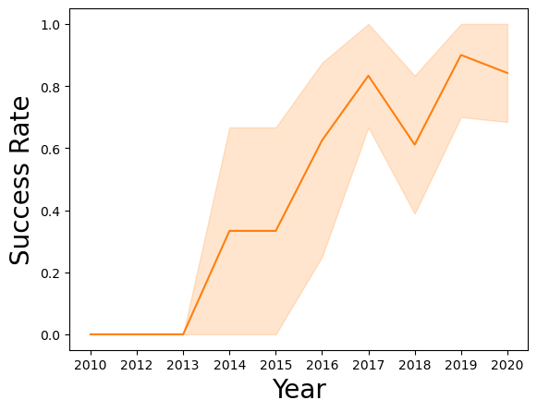
Launch Success Yearly Trend

Slide 24
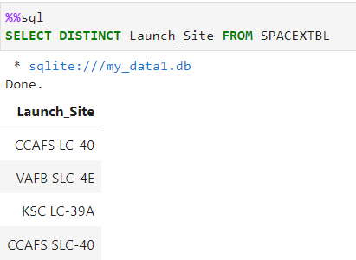
All Launch Site Names

Slide 25
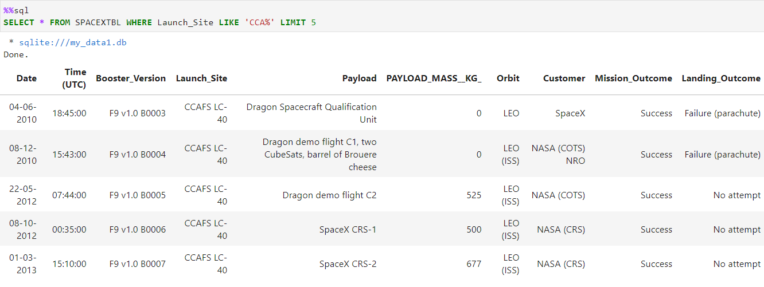
Launch Site Names Begin with 'CCA'

Slide 26
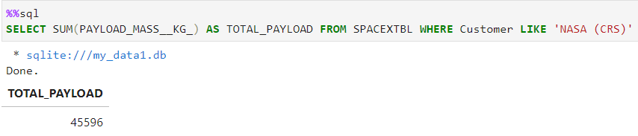
Total Payload Mass

Slide 27
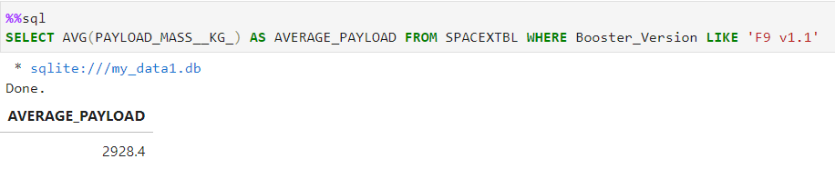
Average Payload Mass by F9 v1.1

Slide 28
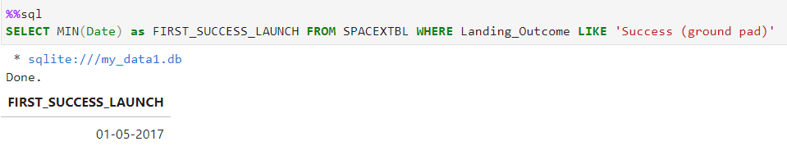
First Successful Ground Landing Date

Slide 29
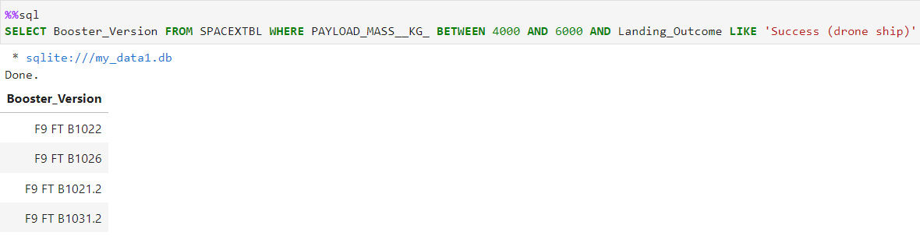
Successful Drone Ship Landing with Payload between 4000 and 6000

Slide 30
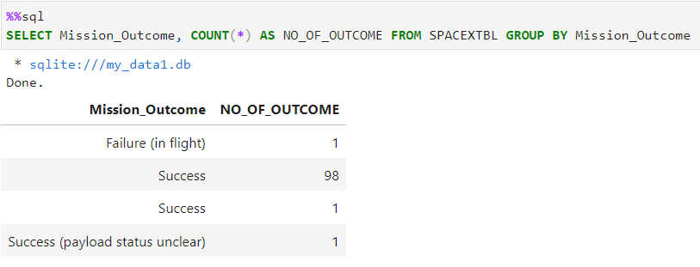
Total Number of Successful and Failure Mission Outcomes

Slide 31
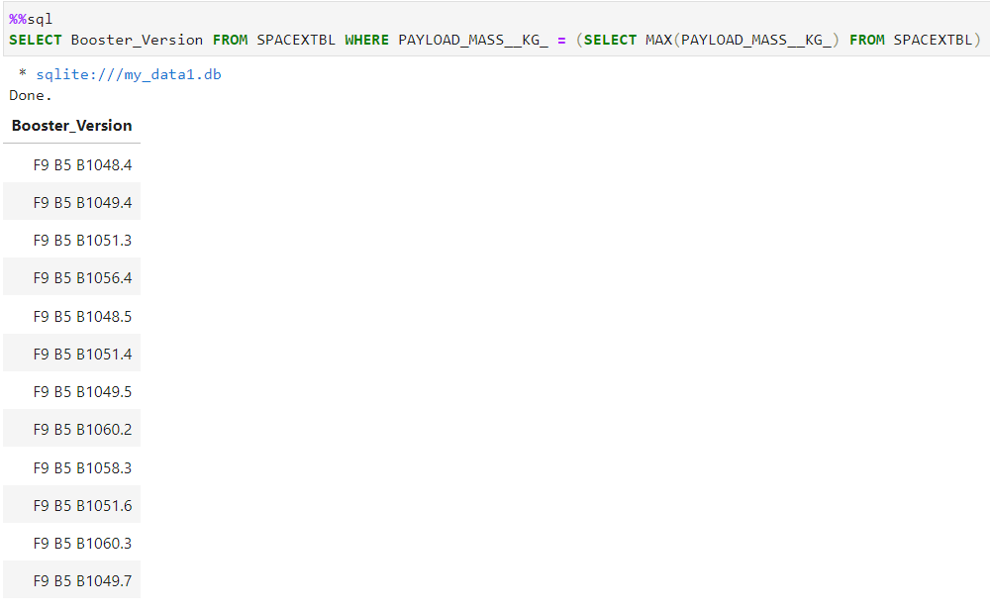
Boosters Carried Maximum Payload

Slide 32
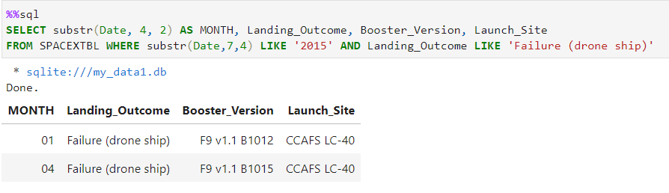
2015 Launch Records

Slide 33
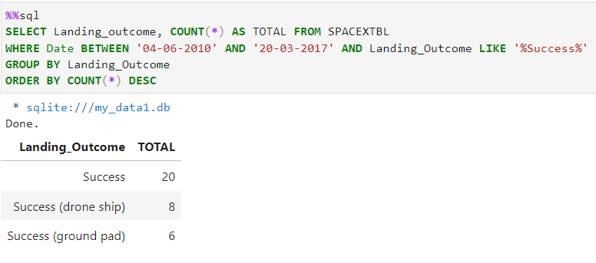
Rank Landing Outcomes Between 2010-06-04 and 2017-03-20

Slide 34

Section 3

Slide 35
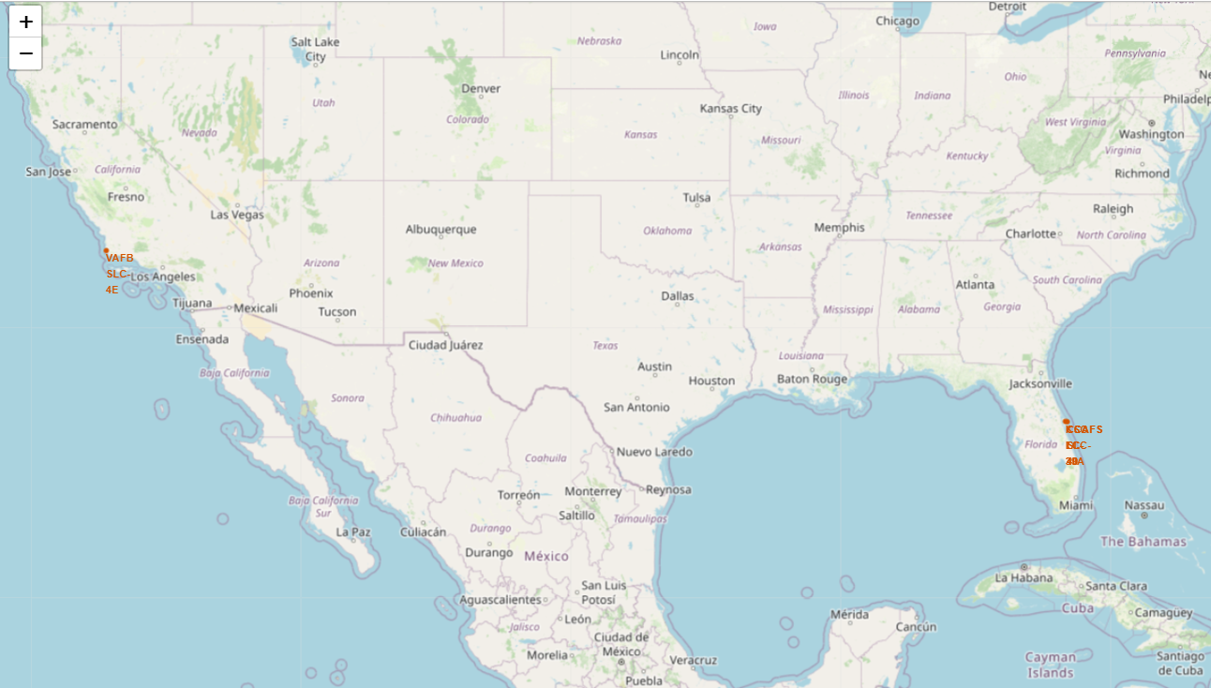
<Folium Map Screenshot 1>

Slide 36
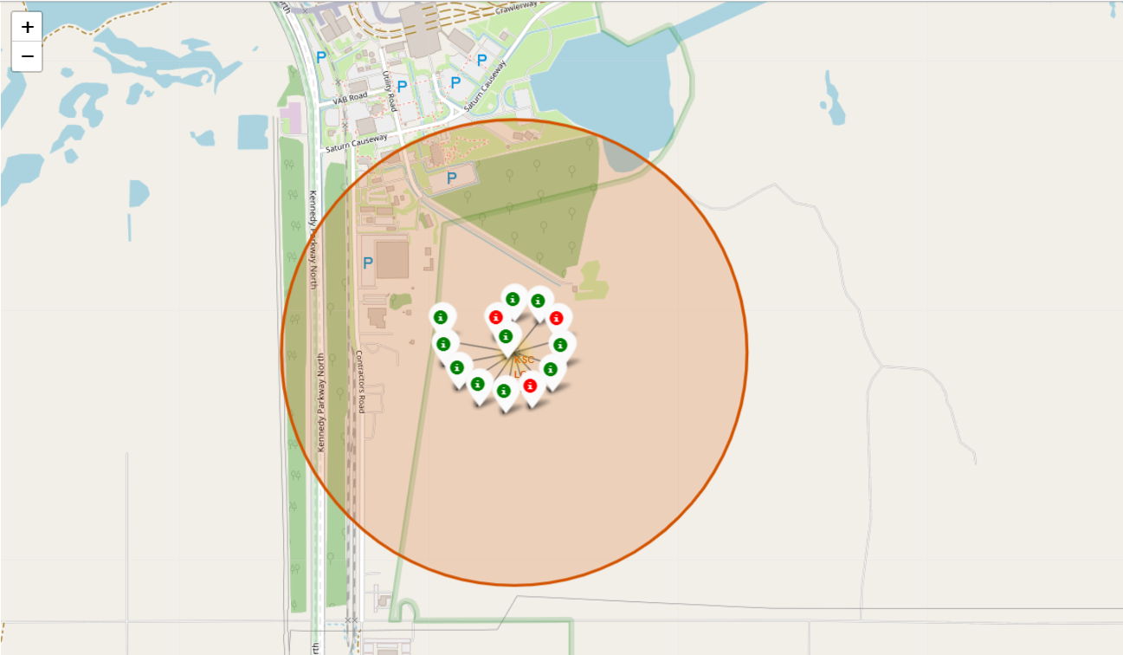
<Folium Map Screenshot 2>

Slide 37
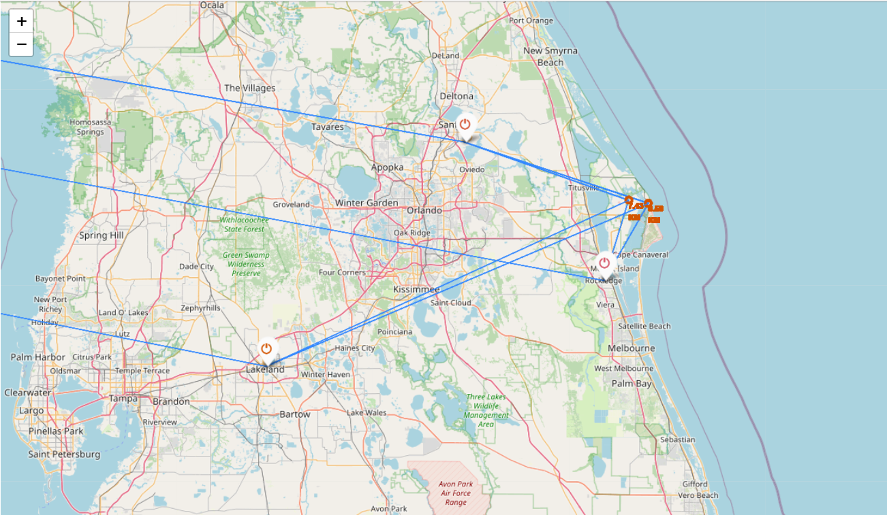
<Folium Map Screenshot 3>

Slide 38

Section 4

Slide 39
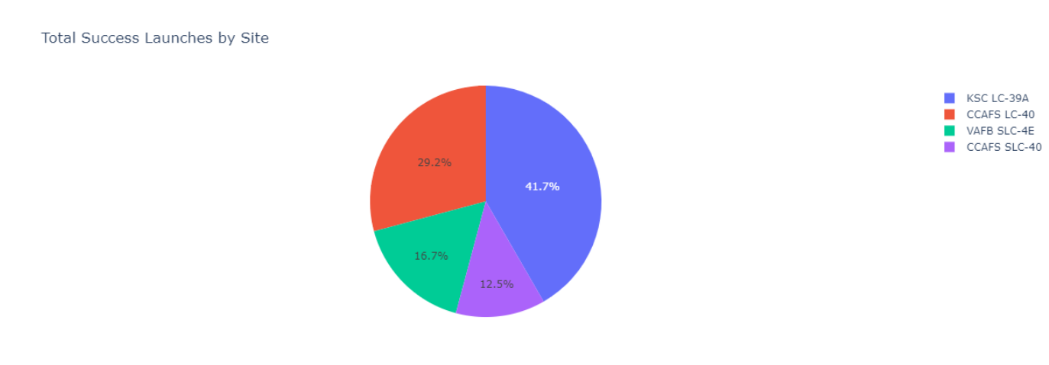
<Dashboard Screenshot 1>

Slide 40

<Dashboard Screenshot 2>

Slide 41
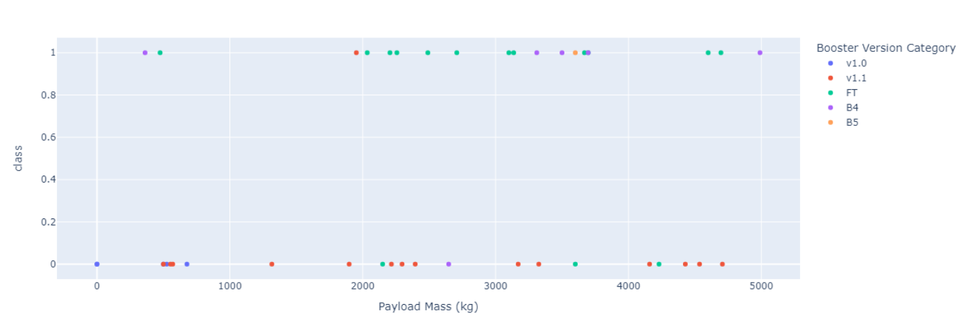
<Dashboard Screenshot 3>

Slide 42

Section 5

Slide 43
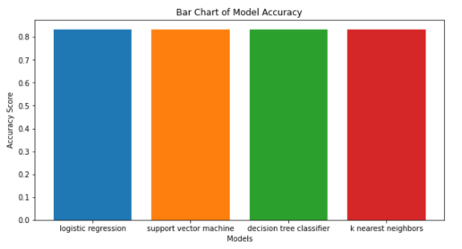
Classification Accuracy
All model produce the same accuracy against the test data set ~94.44

Slide 44
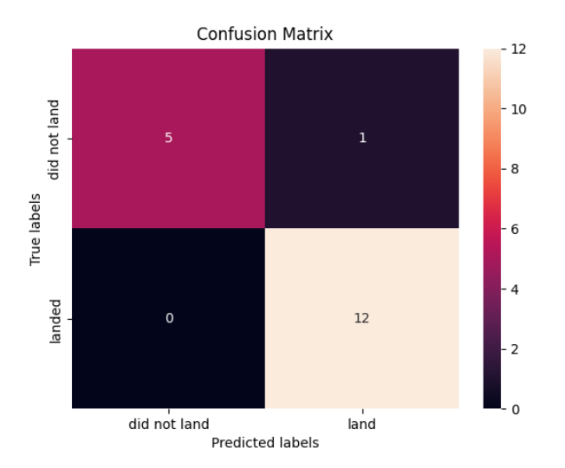
Confusion Matrix
All model generated the same confusion matrix

Slide 45
Conclusions
Goal to develop a machine learning model to predict if stage 1 will successfully land for a given launch
All predicted successful landings with ~94.44 accuracy for some test data. The models tend to predict successful landings, the models could be improved by using more data.

Slide 46
Appendix
Github Link

Slide 47


